Slide 1
Fraud Detection in Financial Transactions
A Comprehensive Analysis and Model Development
Presented by: Nikhil Prashant Kulkarni
Date: 06/25/2024

Slide 2
Project Overview
Objective: To build a robust model to detect fraudulent transactions.
Key Steps:
1) Data Collection and Preprocessing
2) Exploratory Data Analysis (EDA)
3) Feature Engineering
4) Model Training and Evaluation
5) Handling Imbalanced Data
6) Final Model Selection

Slide 3
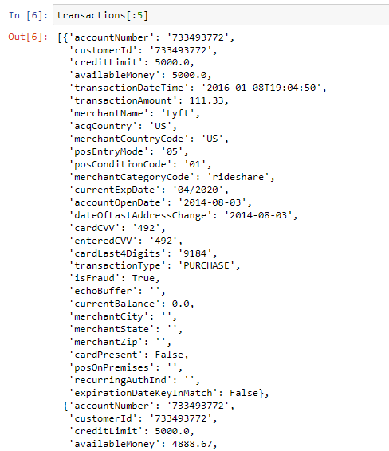
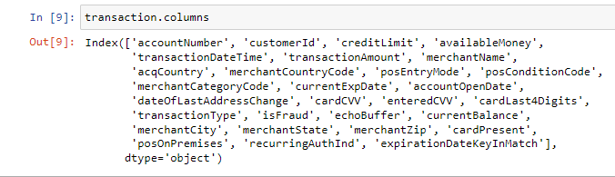
Data Collection
Source: Dataset containing financial transactions (Provided by Capital One), available publicly
Initial Data Size: 641,914 transactions
Attributes:

Slide 4
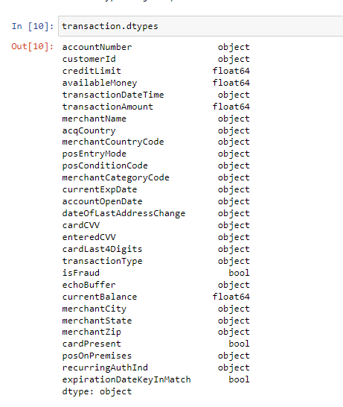
Data Preprocessing
Objective: To clean and prepare the data for analysis and modeling.
Steps:
Convert Date Columns: Converted transactionDateTime, accountOpenDate, dateOfLastAddressChange, and currentExpDate to datetime format.
Convert Numeric Columns: Converted numeric columns stored as strings to integers
Handle Missing Values: Replaced empty strings with NaN to identify all missing values.
Drop Columns: Dropped columns with too many missing values (e.g., echoBuffer, merchantCity).
Fill Missing Values: Used the most frequent value or created a new category for other missing values.
One-Hot Encoding: Converted categorical variables into numerical format using one-hot encoding.

Slide 5
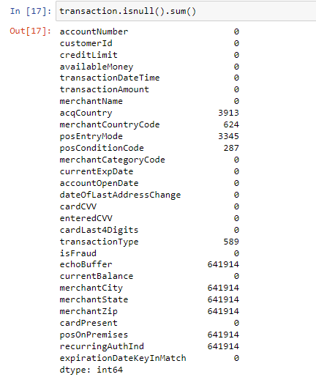
Handle Missing Values
Columns with Missing Values: echoBuffer, merchantCity, merchantState, merchantZip, posOnPremises, recurringAuthInd, acqCountry, merchantCountryCode, posEntryMode, posConditionCode, transactionType.
Approach:
Dropped columns with a high percentage of missing values.
Filled missing values in other columns with the most frequent value or a new category ('00' for posEntryMode).

Slide 6
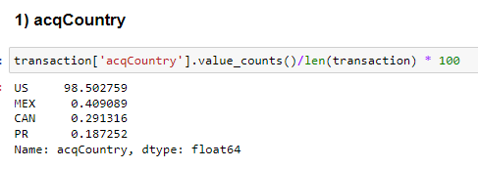
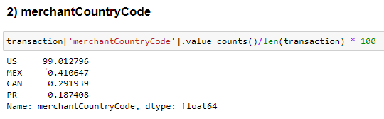
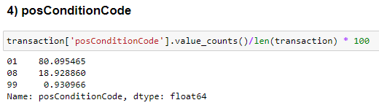
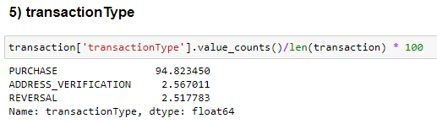
Handle Missing Values (Contd.)
Filling with most frequent values:
Reason to go with most frequent value:
Categorical variable – Can’t go with Mean Imputation
Can use Regression techniques for imputation, but most frequent element will dominate the column by large margin, and would have resulted in the most frequent element only

Slide 7
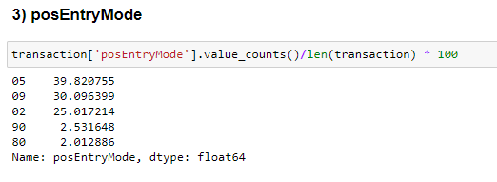
Handle Missing Values (Contd.)
Creating new category:
Reason:
Top 3 categories have around same distribution, so cannot replace with the most frequent element
Can apply multi-class classification to predict the category – High computational task for 0.5% of the rows for a single column, no guarantee of correct imputation

Slide 8
Exploratory Data Analysis (EDA)
Visualizations:
Histogram of Transaction Amount
Mean Transaction Amount by Merchant Category
Transaction Amount for Fraud vs Non-Fraud Transactions
Transaction Frequency by Hour and Day of the Week
Fraud Rate by Merchant Category
Average Transaction Amount by Merchant Category: Fraud vs Non-Fraud
Transaction Type Distribution: Fraud vs Non-Fraud
Credit Limit Distribution: Fraud vs Non-Fraud
Objective: To understand the data distribution and identify patterns.

Slide 9
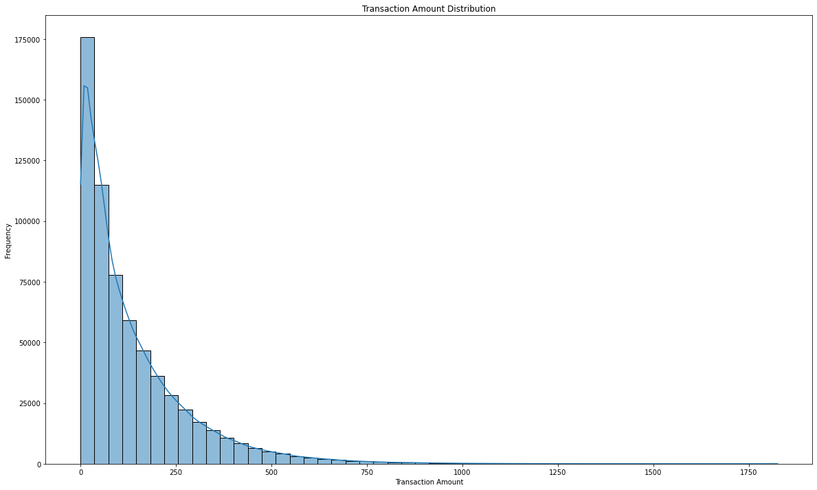
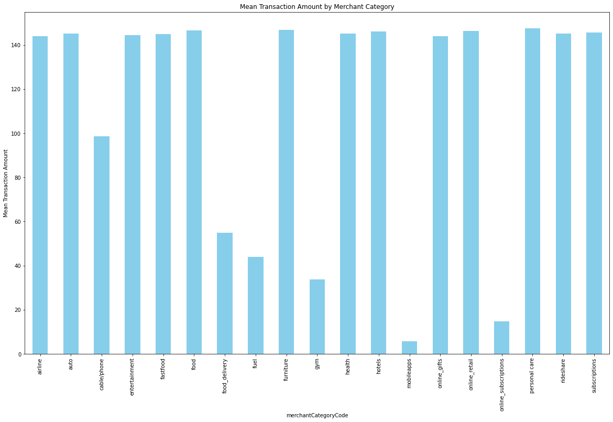
EDA (CONTD.)
Histogram of Transaction Amount
Mean Transaction Amount by Merchant Category
Most transactions are of lower amounts, indicating users frequently use credit cards for smaller transactions.
For most of the merchant categories, average amount is around 140. For fuels, gym, mobile apps and online subscriptions, the average amount lies around 20-40$. The reason is these are monthly one time expenses and generally aren’t much costlier.

Slide 10
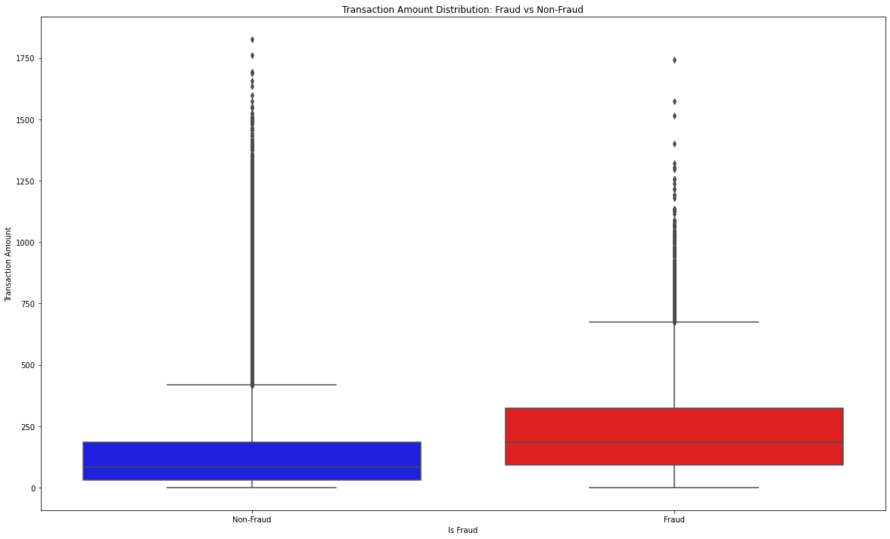
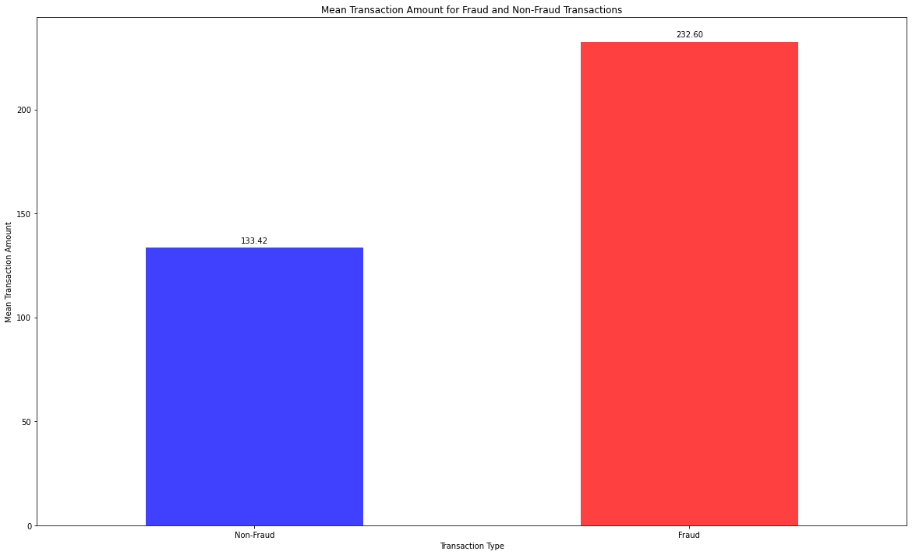
EDA (Contd.)
Transaction Amount for Fraud vs Non-Fraud Transactions
Average amount for fraud transactions is around 232 and for not fraud transaction is much lesser which is 133. So, it is evident that fraud transactions are happening for higher amount while normal transactions have lesser average.

Slide 11
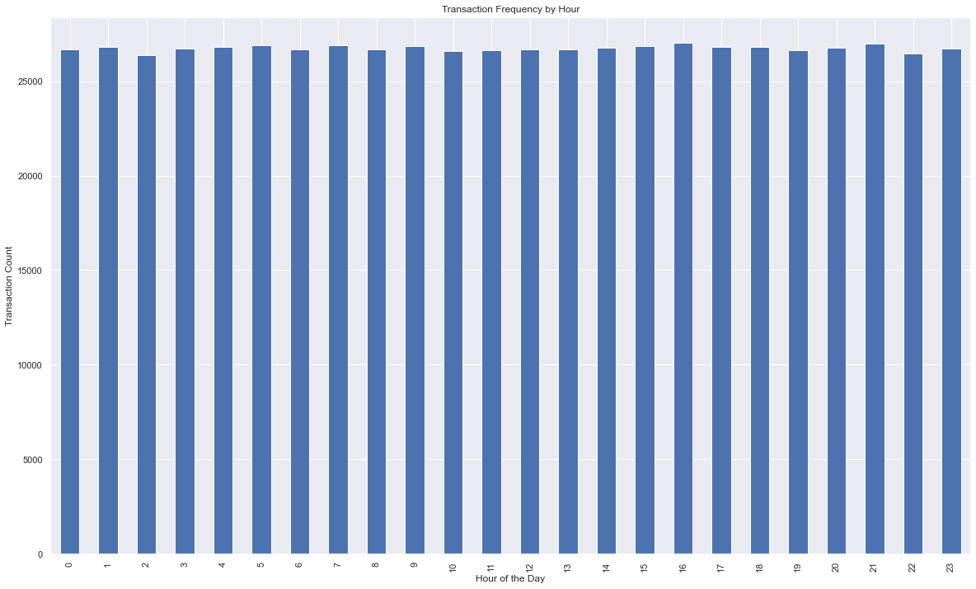
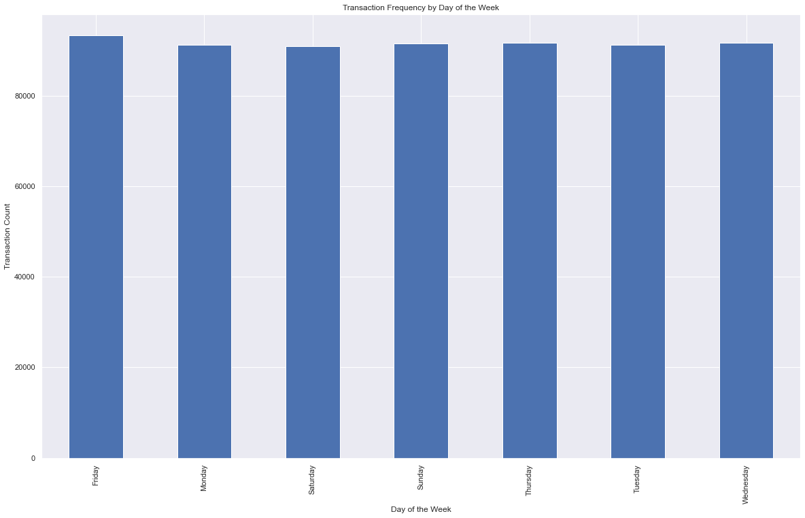
EDA (CONTD.)
Transaction Frequency by Hour and Day of the Week
Transactions are equally distributed

Slide 12
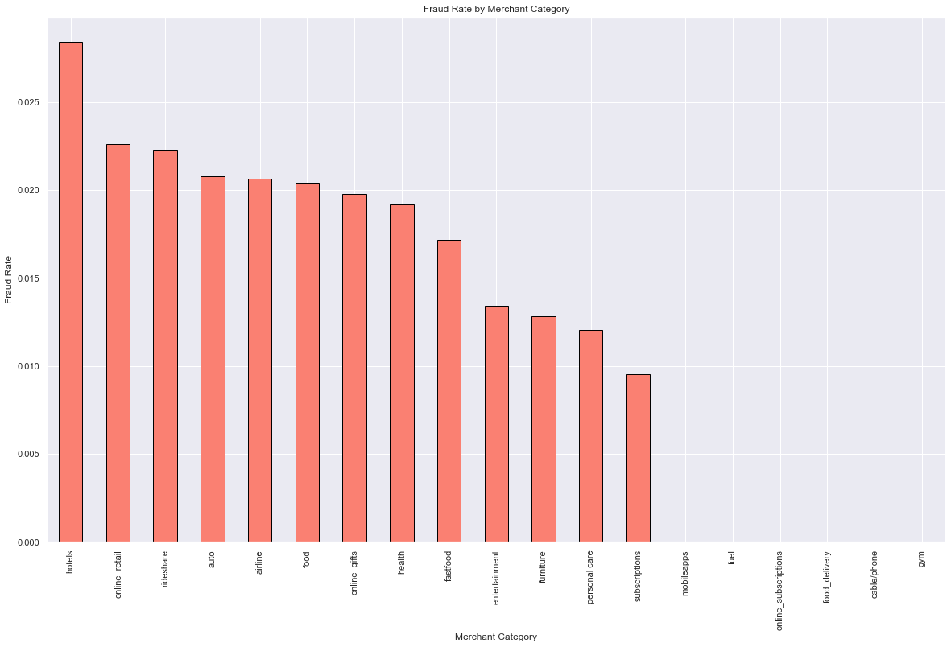
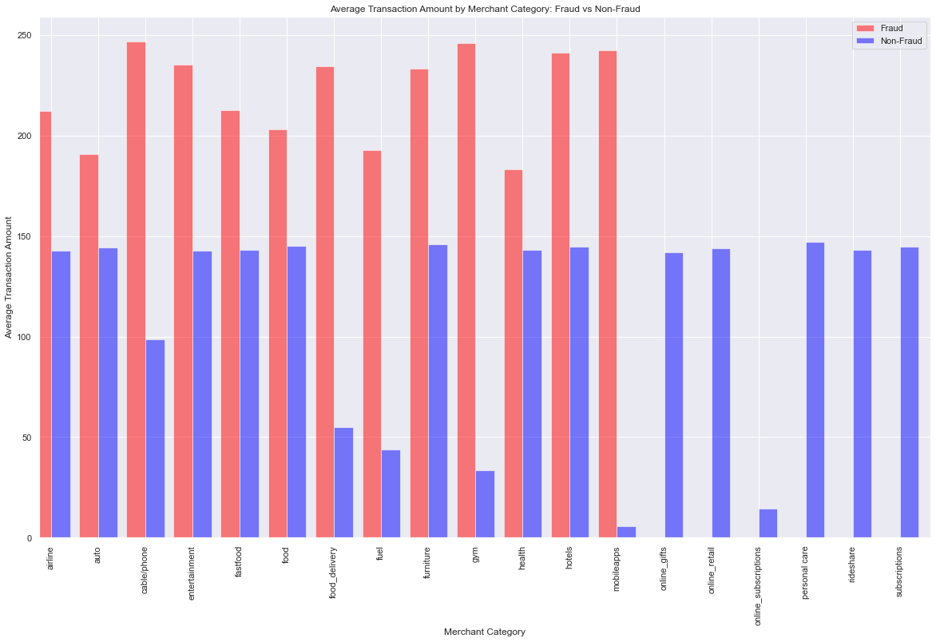
EDA (CONTD.)
Average Transaction Amount by Merchant Category: Fraud vs Non-Fraud
Fraud Rate by Merchant Category
This plot indicates that certain merchant categories are more prone to fraudulent activities. This insight can help in focusing fraud detection efforts on high-risk categories
Fraudulent transactions generally have higher average amounts compared to non-fraudulent transactions across most categories.

Slide 13
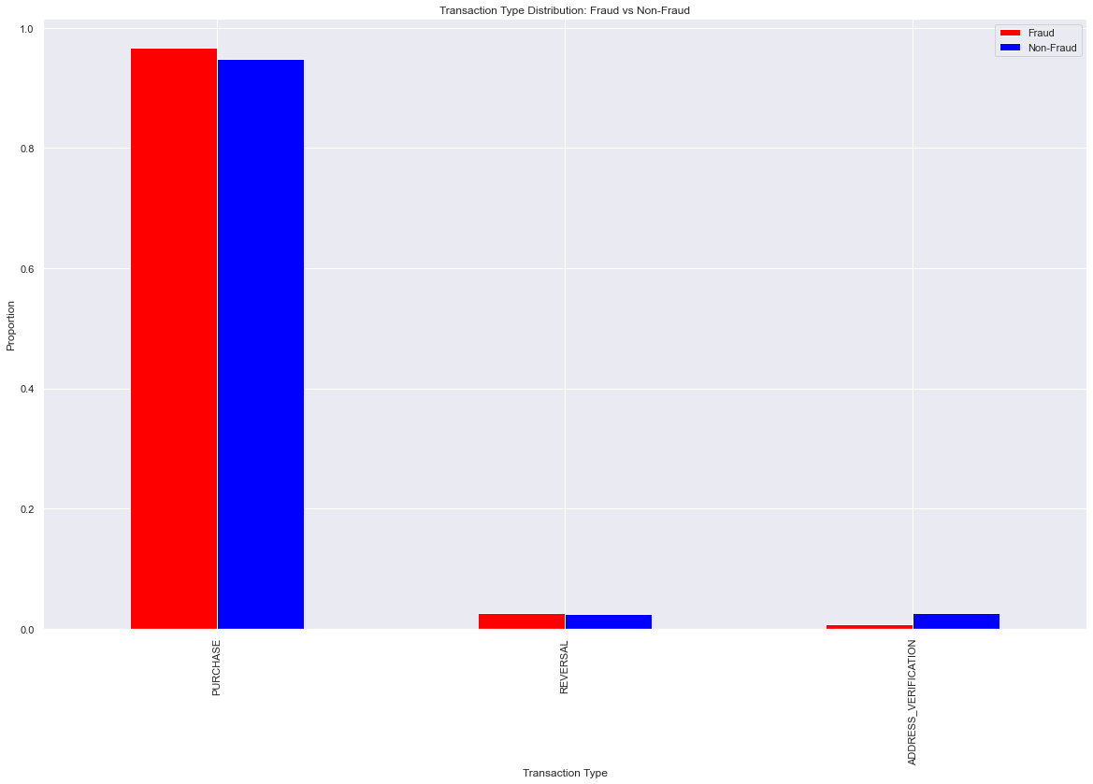
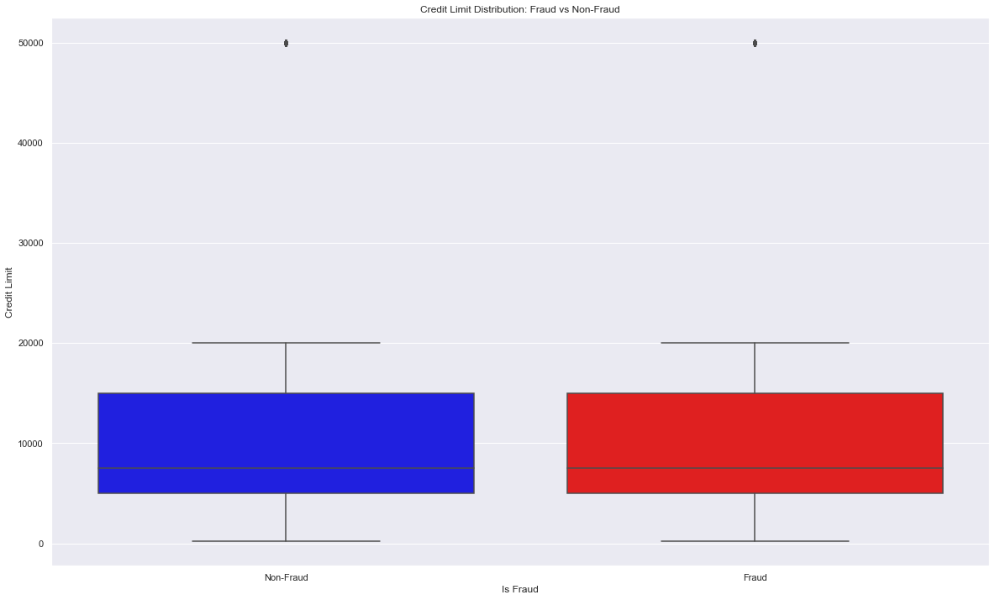
EDA (CONTD.)
Transaction Type Distribution: Fraud vs Non-Fraud
Credit Limit Distribution: Fraud vs Non-Fraud
Fraudulent activities are more likely to be hidden among regular purchase transactions due to their volume
No significant difference in the distribution of credit limits between fraud and non-fraud transactions

Slide 14
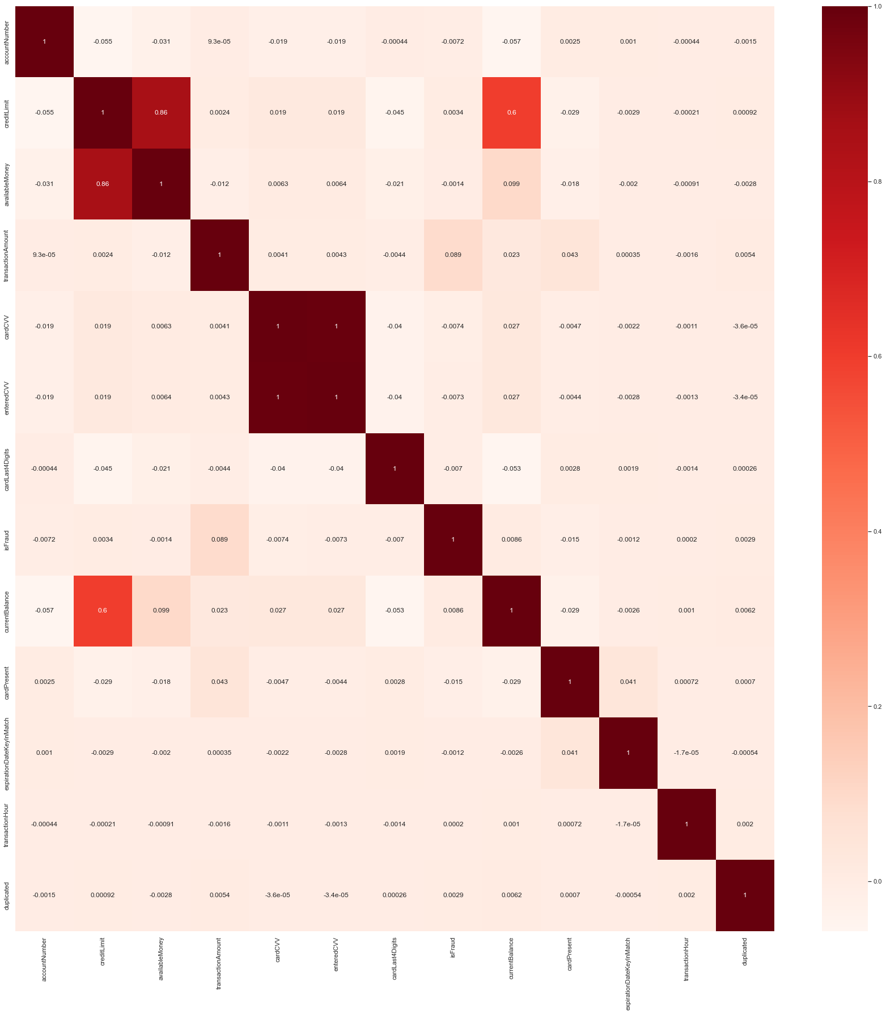
Correlation Analysis
Pearson Correlation:
To find the correlation between numerical variables
Straightforward interpretation of how changes in one variable are associated with changes in another
Measures linear correlation between two continuous variables
Ranges from -1 to +1 (-1 meaning negatively correlated, 0 means no correlation, +1 meaning positively correlated)

Slide 15
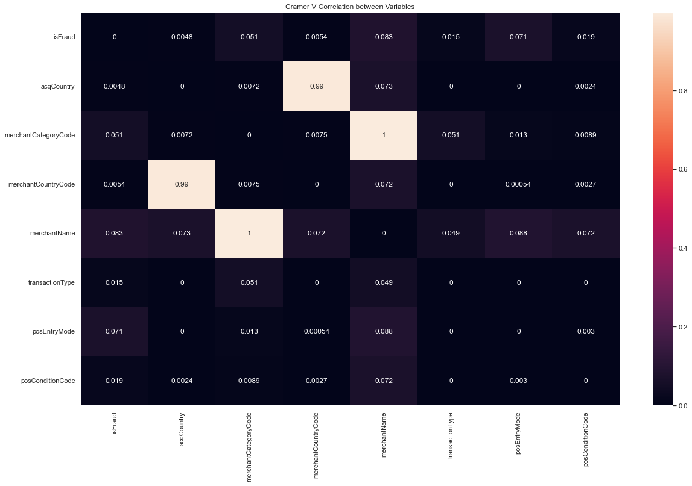
Correlation Analysis
Cramér’s V:
To find the correlation between categorical variables.
Measures association between two categorical variables using chi-squared statistic
Ranges from 0 to 1 (0 meaning no correlation, 1 meaning perfect correlation)

Slide 16
Data Preparation for Modeling
Feature Engineering:
This is a Classification Problem - requires numerical values
Created new features such as day_of_trans, month_of_trans, year_of_trans, hour_of_trans.
Calculated account age, remaining account age, and days since last address change
One-hot encoded categorical variables (Why not ordinal?)
Dropped insignificant features such as accountNumber, CVV, etc

Slide 17
Model Selection
Logistic Regression:
Simple, Interpretable
Effective for binary classification
Estimates the probability that a given input belongs to a certain class (Fraud/Non-Fraud) based on threshold
Random Forest:
Handles large datasets with higher dimensionality
Robust to overfitting
Can capture complex interactions between features
Constructs multiple decision trees during training and outputs the mode of the classes for classification tasks
Other potential models:
Support Vector Machines: Not chosen due to longer training times
Neural Networks: Not chosen due to the need for extensive computational resources and more complex hyperparameter tuning
Gradient Boosting Machines: Not chosen due to higher sensitivity to hyperparameter settings

Slide 18
Model Evaluation Metrics
Accuracy:
Ratio of correctly predicted instances to the total instances
Provides an overall measure of the model’s performance
Can be misleading for imbalanced datasets as it may be high due to the majority class.
Precision:
The ratio of true positive predictions to the total positive predictions
Indicates the model’s ability to correctly identify positive instances (fraudulent transactions)
Ensures that flagged transactions are indeed fraudulent, minimizing false alarms
Recall:
The ratio of true positive predictions to the total actual positives
Measures the model’s ability to identify all relevant instances
Ensures that most fraudulent transactions are caught, reducing financial losses due to undetected fraud.

Slide 19
Model Evaluation Metrics (Contd.)
F1 Score:
The harmonic mean of precision and recall
Provides a single metric that balances both precision and recall
Ensures a good balance between catching fraud and avoiding false positives.
Confusion Matrix:
A table used to describe the performance of a classification model
Shows the true positives, true negatives, false positives, and false negatives
Helps in understanding the model’s prediction errors and areas of improvement.

Slide 20
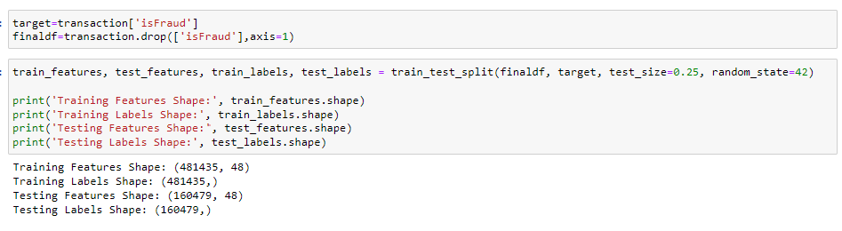
Model Training
Objective: To evaluate model performance on the dataset
Models: Logistic Regression and Random Forest
Need for Scaling the data? No
Logistic Regression performs adequately without scaling if the features are not excessively varied in magnitude
Decision Trees are insensitive to feature scaling

Slide 21
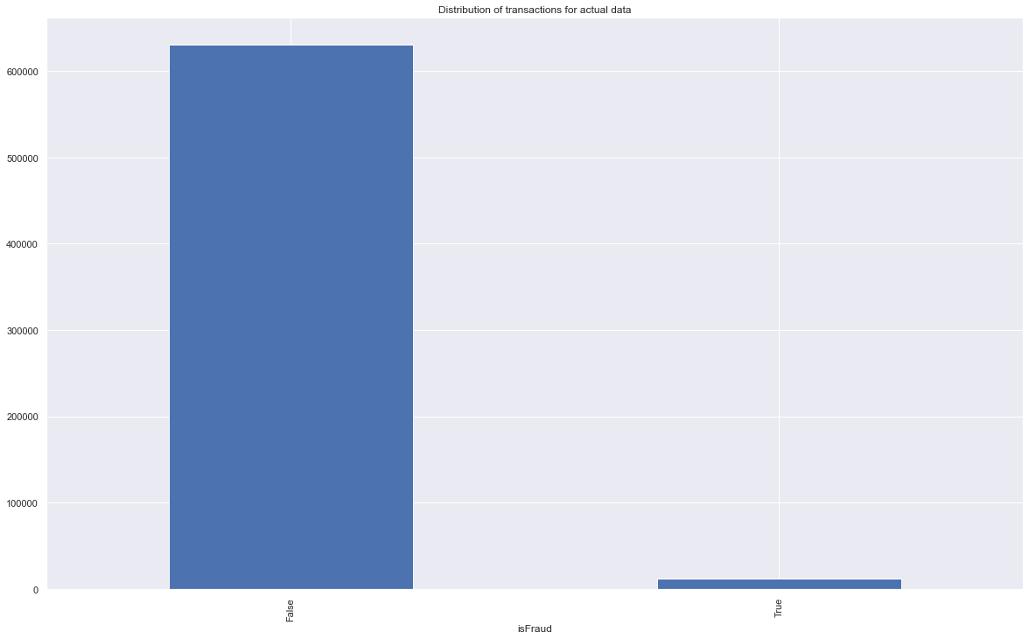


Model Training – Original Data
Results:
1) Logistic Regression
Accuracy (Training Data): 98.25%
Accuracy (Test Data): 98.19%
Precision Score: 0
Recall Score: 0
F1 Score: 0
2) Random Forest
Accuracy (Training Data): 99.99%
Accuracy (Test Data): 98.22%
Precision Score: 0.96
Recall Score: 0.01
F1 Score: 0.03

Slide 22
Handling Imbalanced Data
Classes in the dataset are not represented equally - fraudulent transactions are much fewer compared to non-fraudulent ones
Impact on Prediction:
Models may become biased towards the majority class, leading to high accuracy but poor performance on the minority class (fraud).
The model may miss many fraudulent transactions, which is critical in fraud detection.
Ways to Handle:
Resampling Techniques: Adjust the class distribution by either oversampling the minority class or undersampling the majority class.

Slide 23
Handling Imbalanced Data (Contd.)
Types of Downsampling:
Random Downsampling:
Randomly removes samples from the majority class to balance the dataset
Simple to implement, reduces training time
May result in loss of important information, leading to underfitting
Cluster Centroid Downsampling:
Reduces the majority class by clustering and using the cluster centroids as representatives
Retains more information compared to random downsampling
More complex to implement, may still lose some variability in the data
Types of Upsampling:
Random Upsampling:
Randomly duplicates samples from the minority class to balance the dataset
Simple to implement, retains all original data
Can lead to overfitting, as the model may memorize duplicated samples
SMOTE (Synthetic Minority Over-sampling TEchnique)
Generates synthetic samples for the minority class by interpolating between existing samples.
Reduces overfitting, improves generalization by creating more diverse samples
More complex to implement, can introduce noise if not done carefully

Slide 24


Model Training – Downsampling
Results:
1) Logistic Regression
Accuracy (Training Data): 67.15%
Accuracy (Test Data): 66.82%
Precision Score: 0.67
Recall Score: 0.65
F1 Score: 0.66
2) Random Forest
Accuracy (Training Data): 94.10%
Accuracy (Test Data): 69.42%
Precision Score: 0.68
Recall Score: 0.71
F1 Score: 0.70

Slide 25
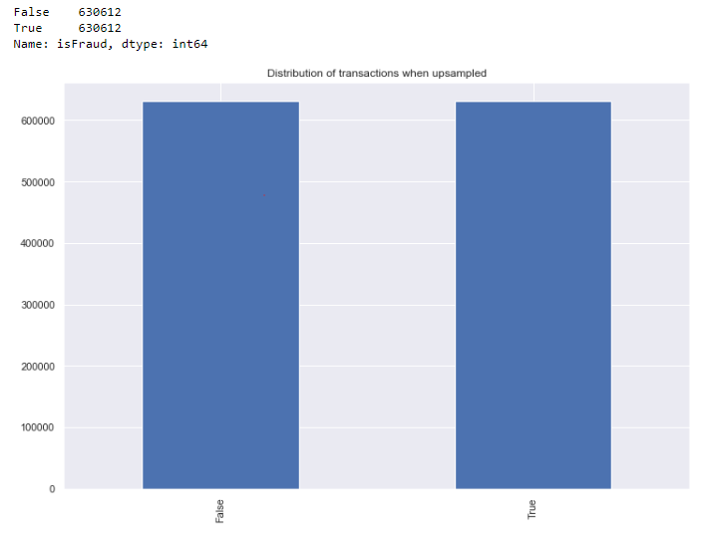
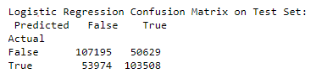
Model Training– Upsampling
Results:
1) Logistic Regression
Accuracy (Training Data): 66.9%
Accuracy (Test Data): 66.82%
Precision Score: 0.67
Recall Score: 0.67
F1 Score: 0.66
2) Random Forest
Accuracy (Training Data): 99.99%
Accuracy (Test Data): 99.98%
Precision Score: 0.99
Recall Score: 0.99
F1 Score: 0.99

Slide 26

Final Model Selection
Selected Model: Random Forest with SMOTE
Reason: Achieved near-perfect precision and recall, ensuring comprehensive fraud detection
Impact: Enhanced ability to detect fraudulent transactions, minimizing financial loss
Future Work: Regular updates and exploring ensemble models for further improvement (SVM, Neural networks)

Slide 27
QUESTIONS AND DISCUSSION

